Slide 1
Python File Access – Nov 26
Agenda
B.8 – File Access
Complete Basic Questions / Programming
Enhanced Programming (Optional)
Previous Work
B.7 – ASCII Encoding
A.5 Student Questions 1 to 6
Upcoming
Tomorrow: Programming Assignment (Evaluation)

Slide 2

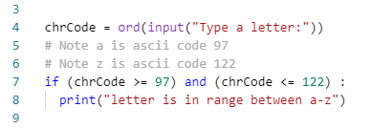
Programming Hints
Opening a file for read, write, append:
Checking a range of letters:

